Slide 1
Presentation
Crossing the digital divide with a simple bridge in the uThukela district, Kwazulu-Natal.

Slide 2
Digital Dynamos
Group Members:
Lefa Mashabela
Nare Legodi
Ndivhuwo Khorommbi
Takalani Mukhavhuli
Temosho Nkgoeng

Slide 3

Agenda:
Introduction
Challenges
Proposed solution
Limitations
Budget
Technical approaches & Training support and Network visual
Conclusion

Slide 4
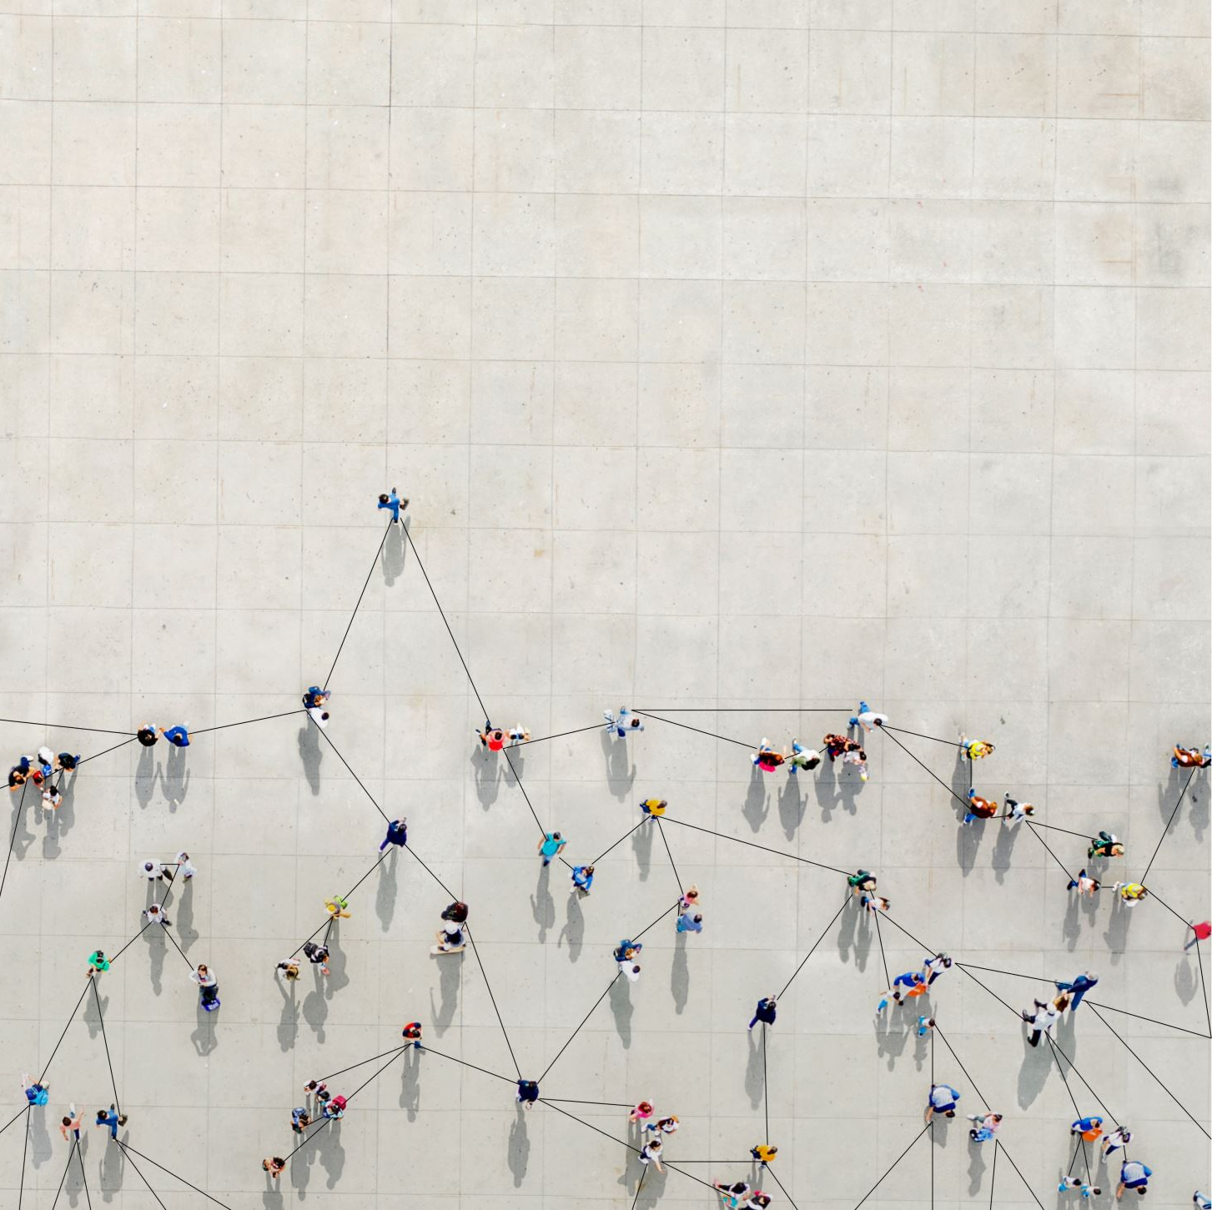
Introduction
Project overview
Goal: Reliable, fast network
Sustainable model
One-year timeline

Slide 5

Challenges
Outdated computers (20 PCs, 5 printers)
Weak network security
Inefficient data storage
Missing patient files
Disconnected software systems

Slide 6

Proposed Solution
Extend reliable network to client site
Install advanced security systems
Centralized data storage system
Train ICT and hospital staff
Ensure software integration

Slide 7

Limitations
Outdated hardware constraints
Possible budget restrictions
Staff skill gaps
Equipment supply delays
Maintenance cost projections

Slide 8

Visual - Budget Breakdown
Network, hardware, security, training

Slide 9

Budget Overview
Network installation: R50,000
2. Hardware upgrade: R30,000
3. Security systems: R20,000
4. Training costs: R10,000
5. Maintenance fund: R15,000

Slide 10

Technical Approach
Fiber-optic network extension
VPN for secure access
Firewalls and encryption
Cloud data backups
Real-time system monitoring

Slide 11
Training & Support
Train ICT staff on network management
Hospital staff: equipment handling
Provide user manuals and guides
Troubleshooting workshops
Continued post-launch support

Slide 12
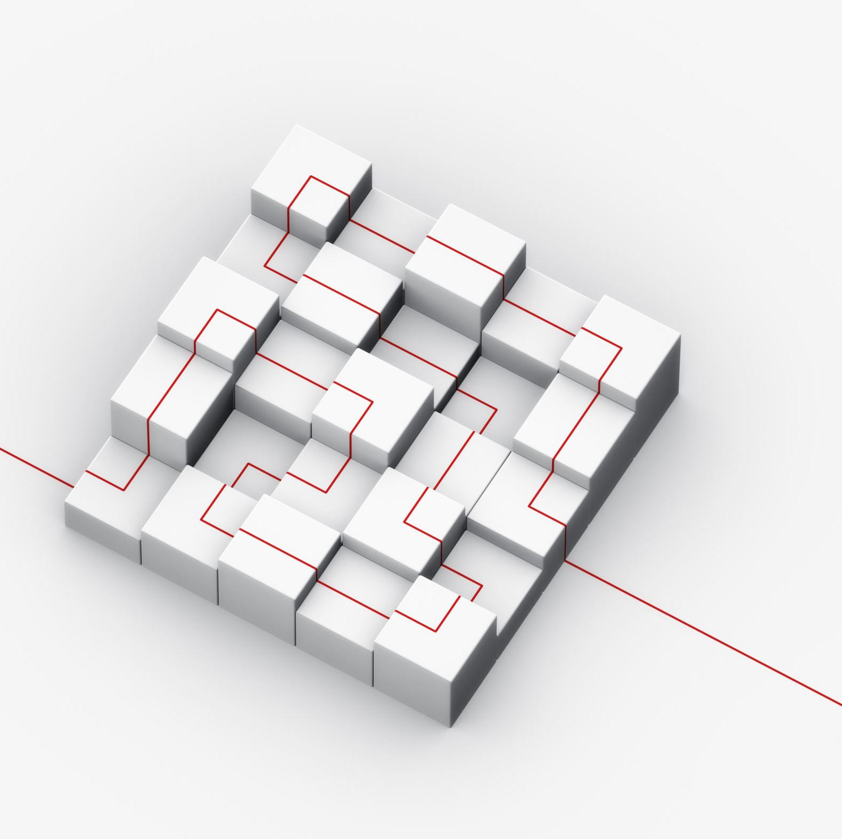
Visual - Network Layout
Diagram showing network structure
Main hospital to client site
Labelled hardware and connections

Slide 13
Conclusion
Reliable network improved efficiency
Self-sustaining model
Timeline: 1 year to completion
Clear benefits for the hospital

Slide 14

Thank You

